Slide 1
Do Now
Are these fragments or sentences? If it is a fragment, please write a correction.
When you are worried, talk things over with someone who cares. Don’t keep your troubles bottled up inside.
Using a paper clip to pick the lock. Archie was able to open the locked door.

Slide 2
Cask of Amontillado
By E.A. Poe

Slide 3
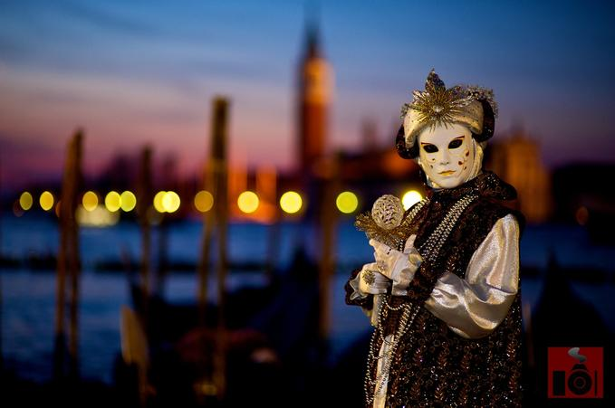
Venice, Italy

Slide 4
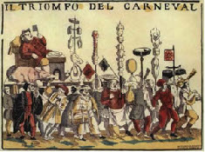
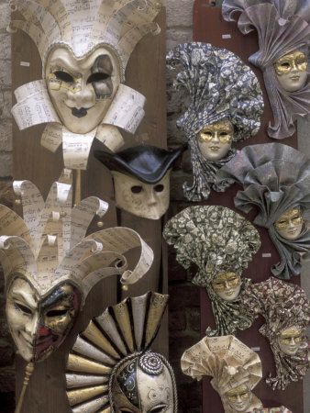
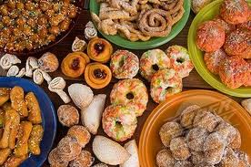
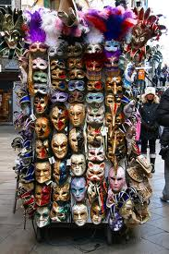
Carnival

Slide 5
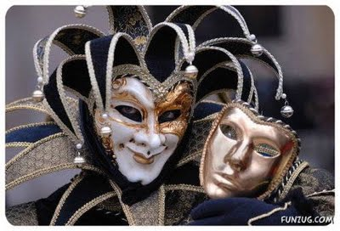
“The man wore motley. He had on a tight-fitting parti-striped dress and his head was surmounted by the conical cap and bells.”

Slide 6
Is he sincere?
When Montresor says he was, “so pleased to see him,” is he being honest? Explain.

Slide 7
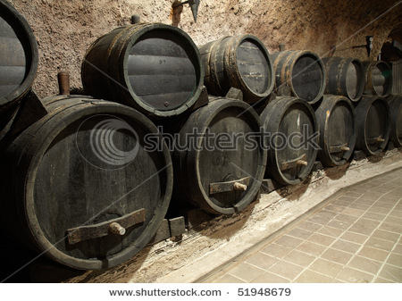
“…a PIPE OF WHAT PASSES FOR Amontillado…”

Slide 8
“And yes some fools will have it…”
What is Montresor doing here?

Slide 9
“These orders were sufficient…”

Slide 10
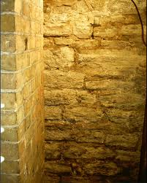
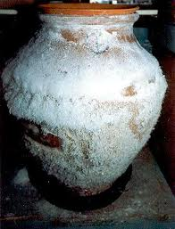
“…encrusted with Nitre.”

Slide 11
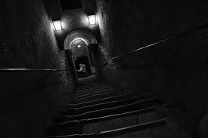
“We came at length to the foot of the descent… on the damp ground of the catacombs of the montresors.”

Slide 12
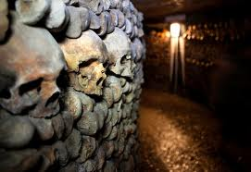
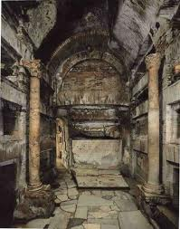
Catacombs

Slide 13
Nemo me impune lacessit
No one harasses me with impunity.

Slide 14
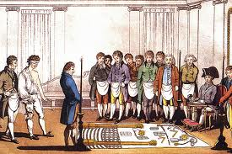
“… you are not of the brotherhood.”

Slide 15
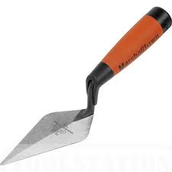
“Yes, yes,” I said…”

Slide 16
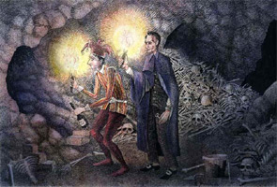
“we perceived a still interior recess…”

Slide 17
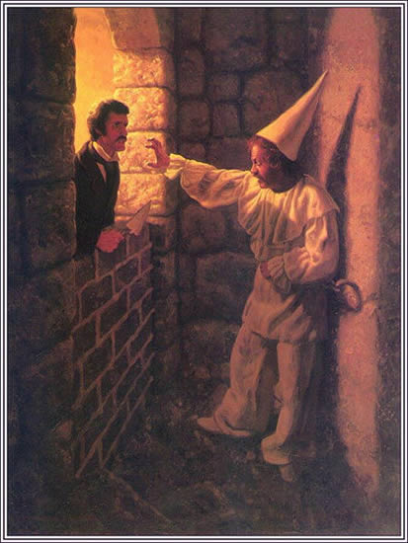
“For the love of god, montresor!”

Slide 18
Exit Ticket
Does not telling us what Fortunato did to offend Montresor add to the suspense? Explain.

